Slide 1
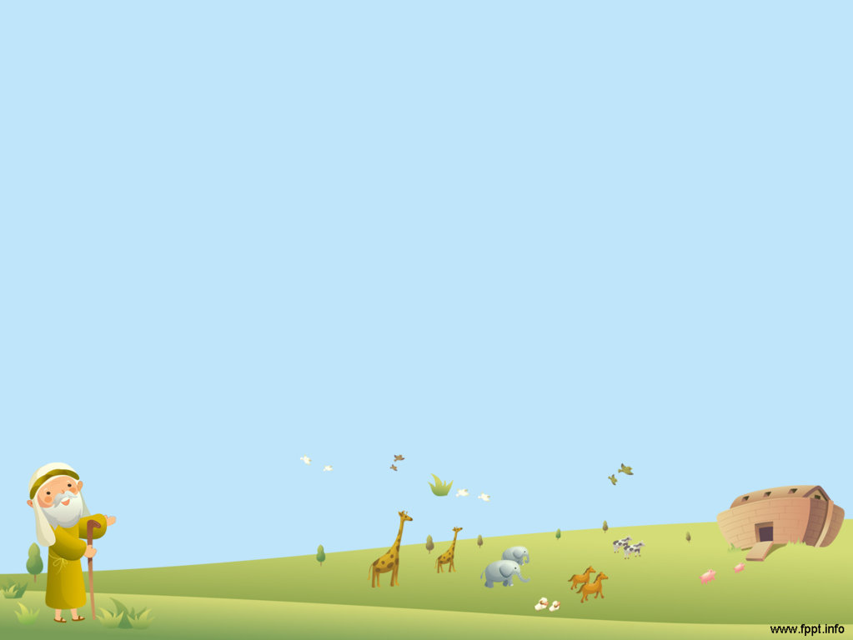
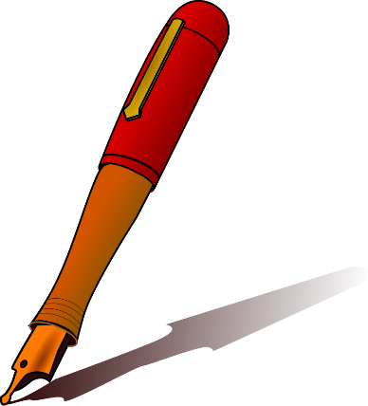

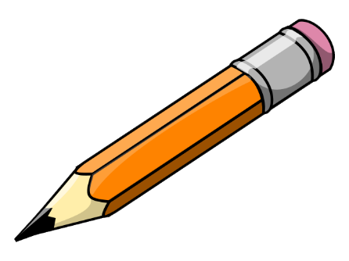
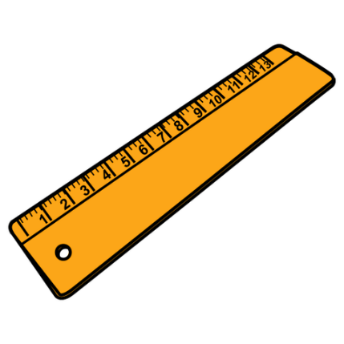
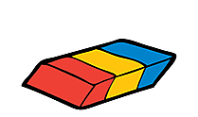
SCHOOL SUPPLIES

Slide 2
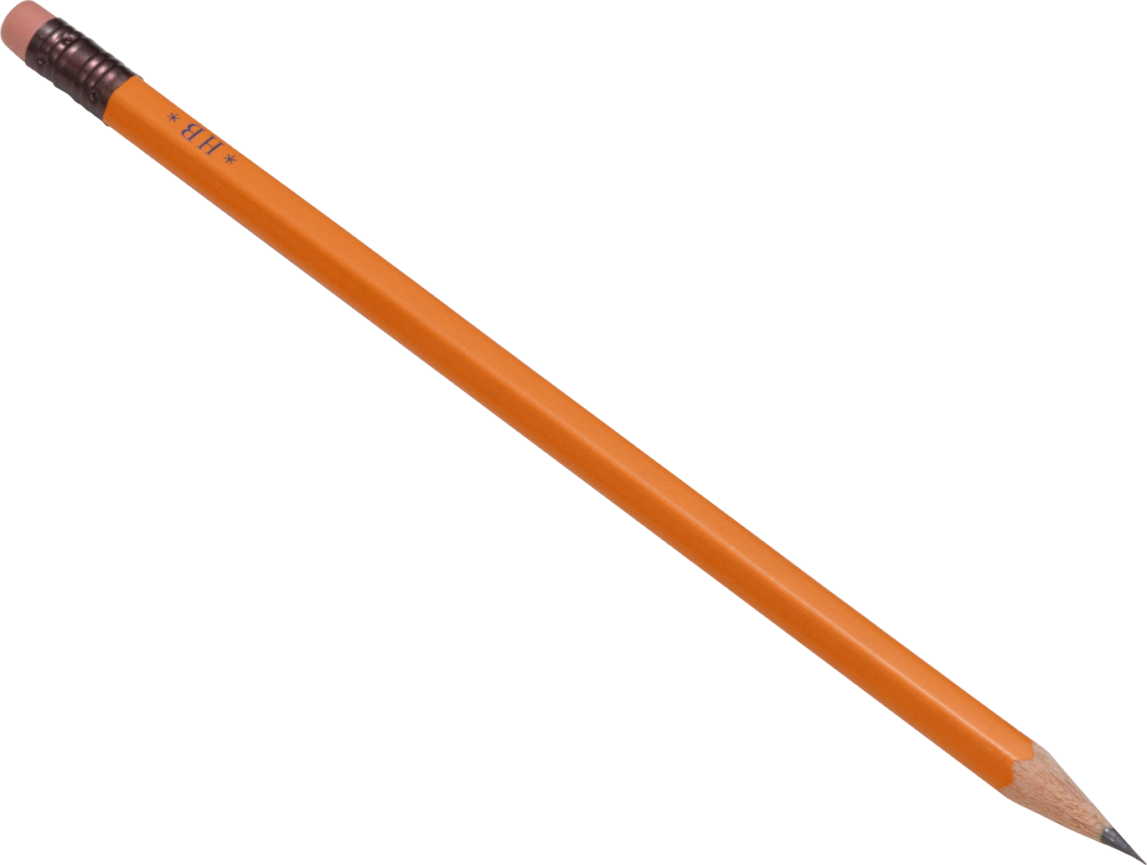
SCHOOL SUPPLIES
pencil

Slide 3
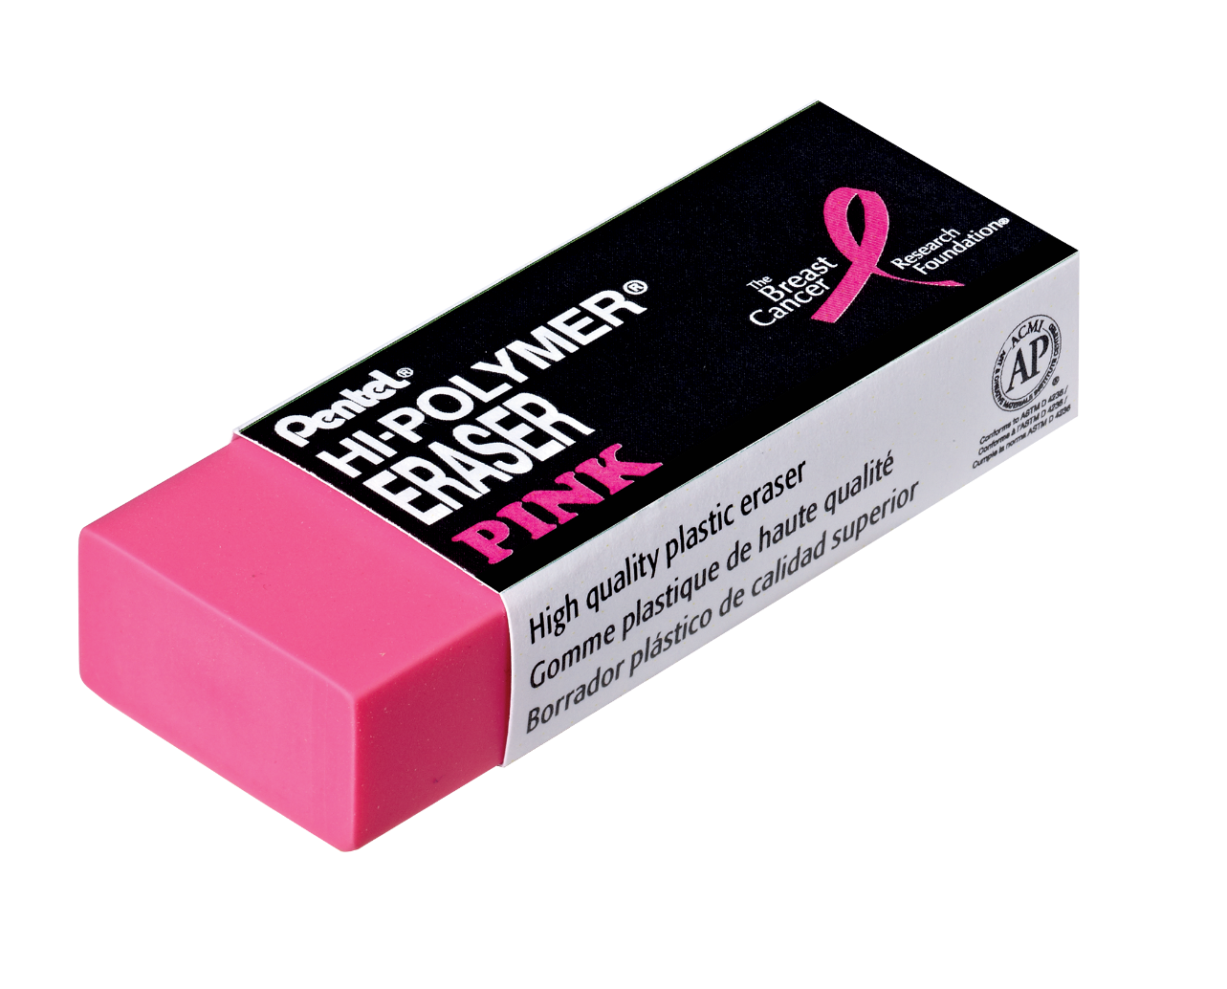
SCHOOL SUPPLIES
rubber

Slide 4
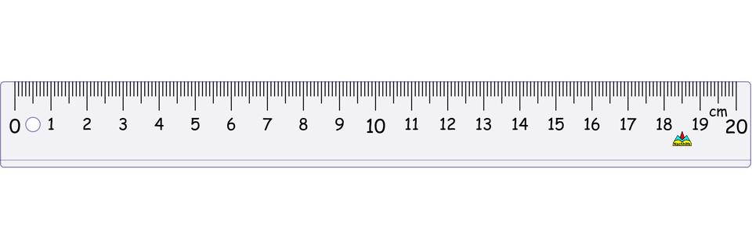
SCHOOL SUPPLIES
ruler

Slide 5
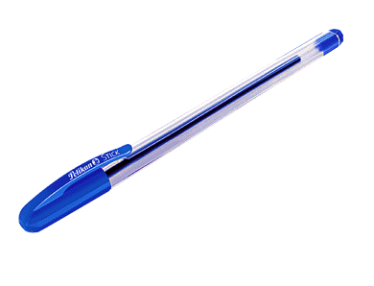
SCHOOL SUPPLIES
pen

Slide 6
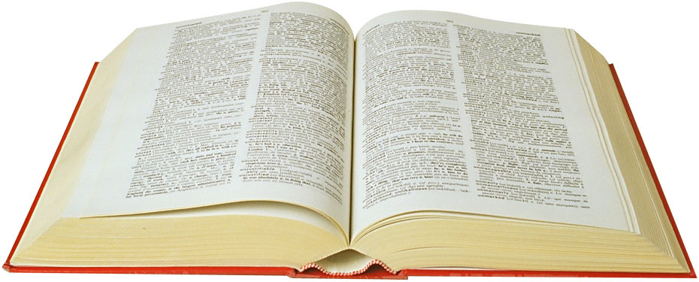
SCHOOL SUPPLIES
book

Slide 7
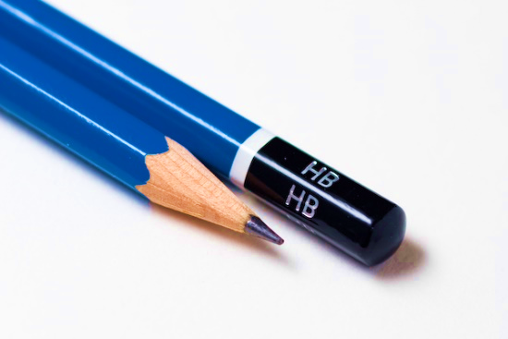
SCHOOL SUPPLIES
Circle the correct word.
1. pen
2. pencil

Slide 8
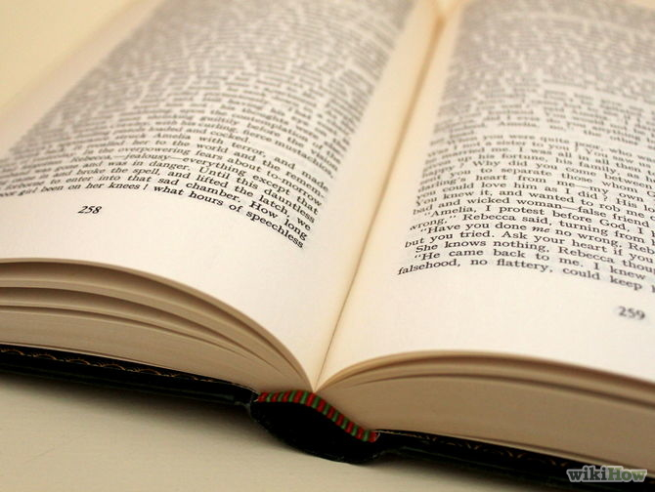
SCHOOL SUPPLIES
Circle the correct word.
1. book
2. ruler

Slide 9
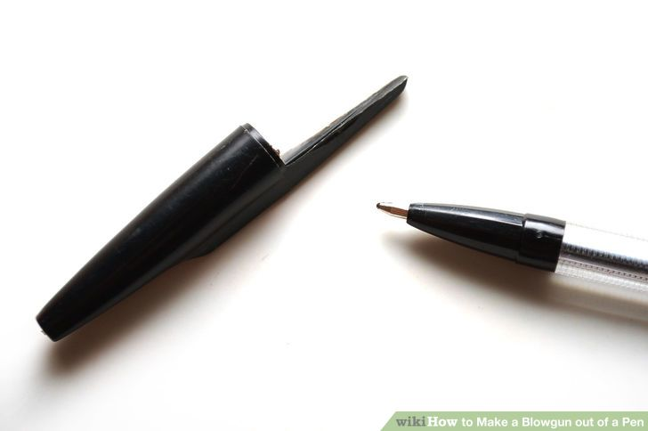
SCHOOL SUPPLIES
Circle the correct word.
1. pen
2. rubber

Slide 10
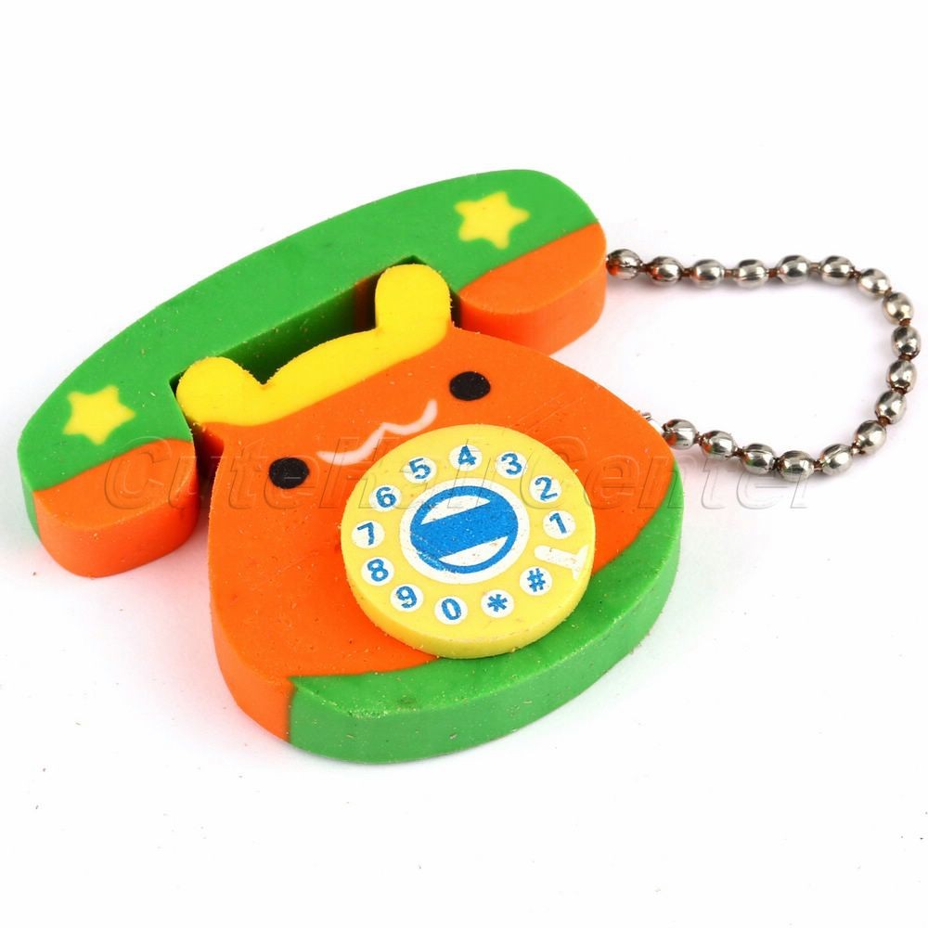
SCHOOL SUPPLIES
Circle the correct word.
1. pencil
2. rubber

Slide 11
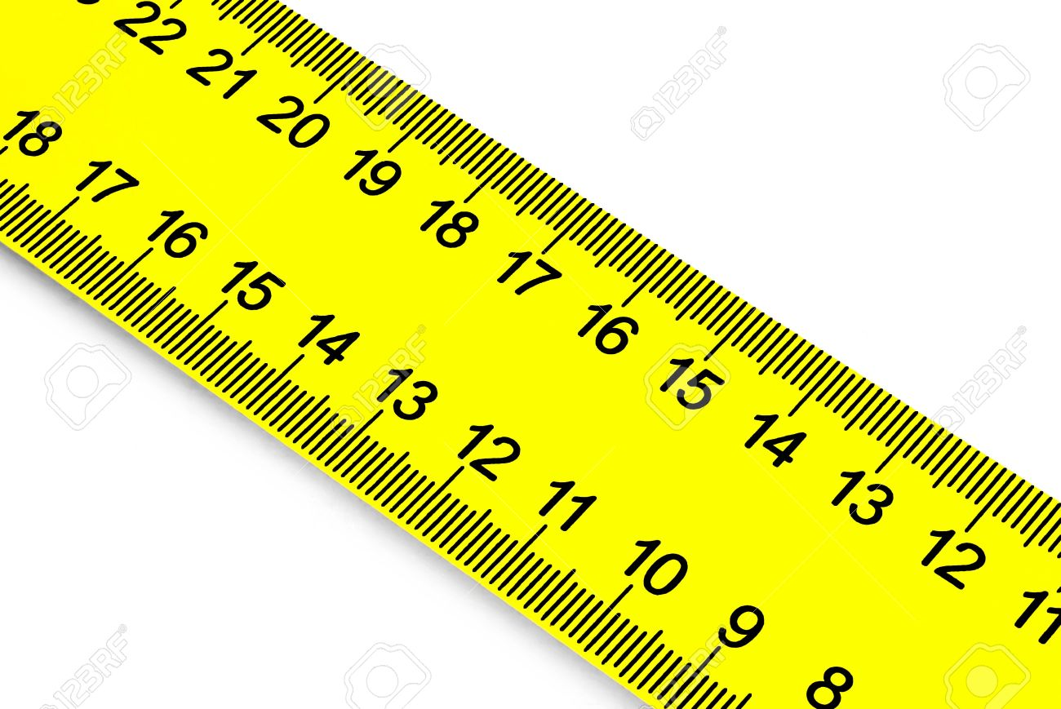
SCHOOL SUPPLIES
Circle the correct word.
1. rubber
2. ruler

