Slide 1
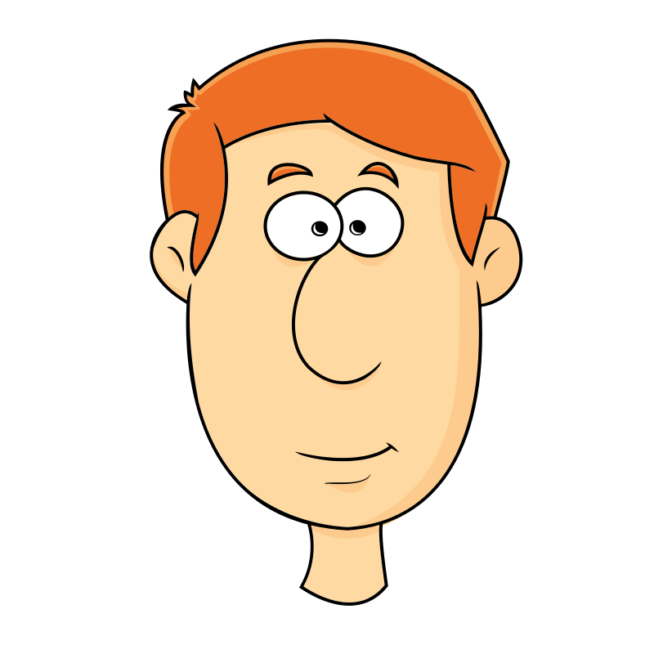

WHO AM I?
DESCRIBING PEOPLE
Read and match.

Slide 2
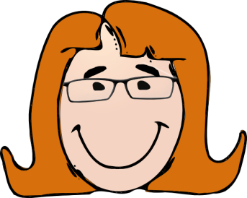
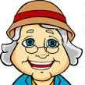
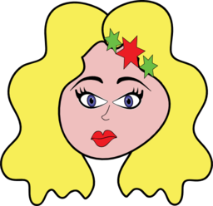
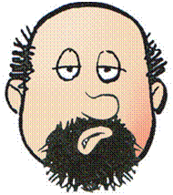
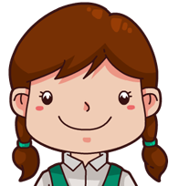

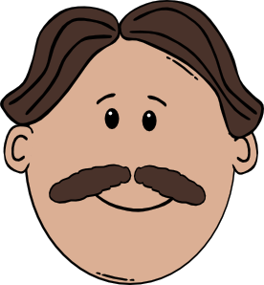
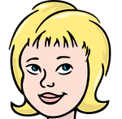
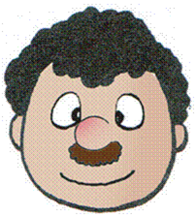
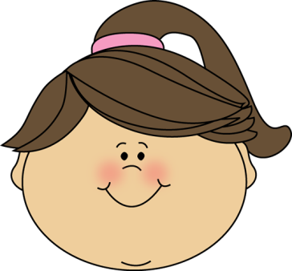
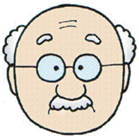
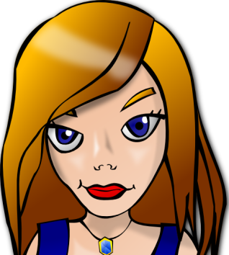
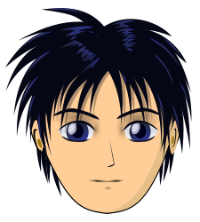
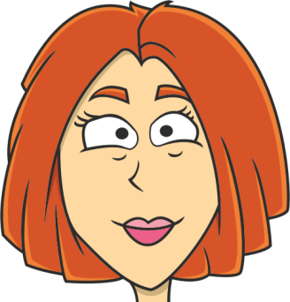
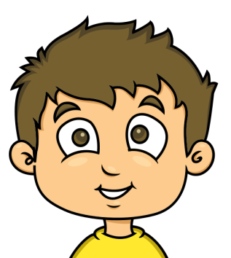
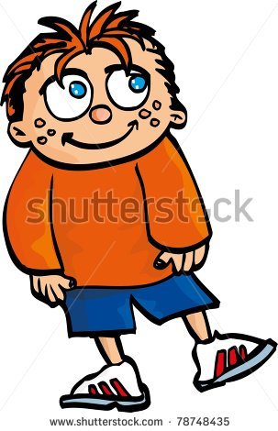


I have got curly black hair, a big
nose and a small moustache.

Slide 3
I am old. I have got big
blue eyes and grey hair.

Slide 4
I have got red spiky hair
and some freckles.

Slide 5
I am young. I have got pigtails.
My nose and my eyes are small.

Slide 6
I have got long wavy hair,
a round face and red lips.

Slide 7
I have got big brown eyes
and a square face.

Slide 8
I am bald and wear glasses.
I have a moustache.

Slide 9
My hair is fair and short.
I have got a small fringe.

Slide 10
I’ve got long hair, small
eyes and a big mouth.

Slide 11
I’ve got an oval face and
medium-length hair.

Slide 12
I’m middle-aged. I’ve got
brown hair and a moustache.

Slide 13
I’ve got long straight hair
and big blue eyes.

Slide 14
I’m bald
but I have got a beard.

Slide 15
I’ve got a round face
and a ponytail.

Slide 16

I’ve got short straight black
hair and big eyes.

